Slide 1
Natalia Cowie

Slide 2
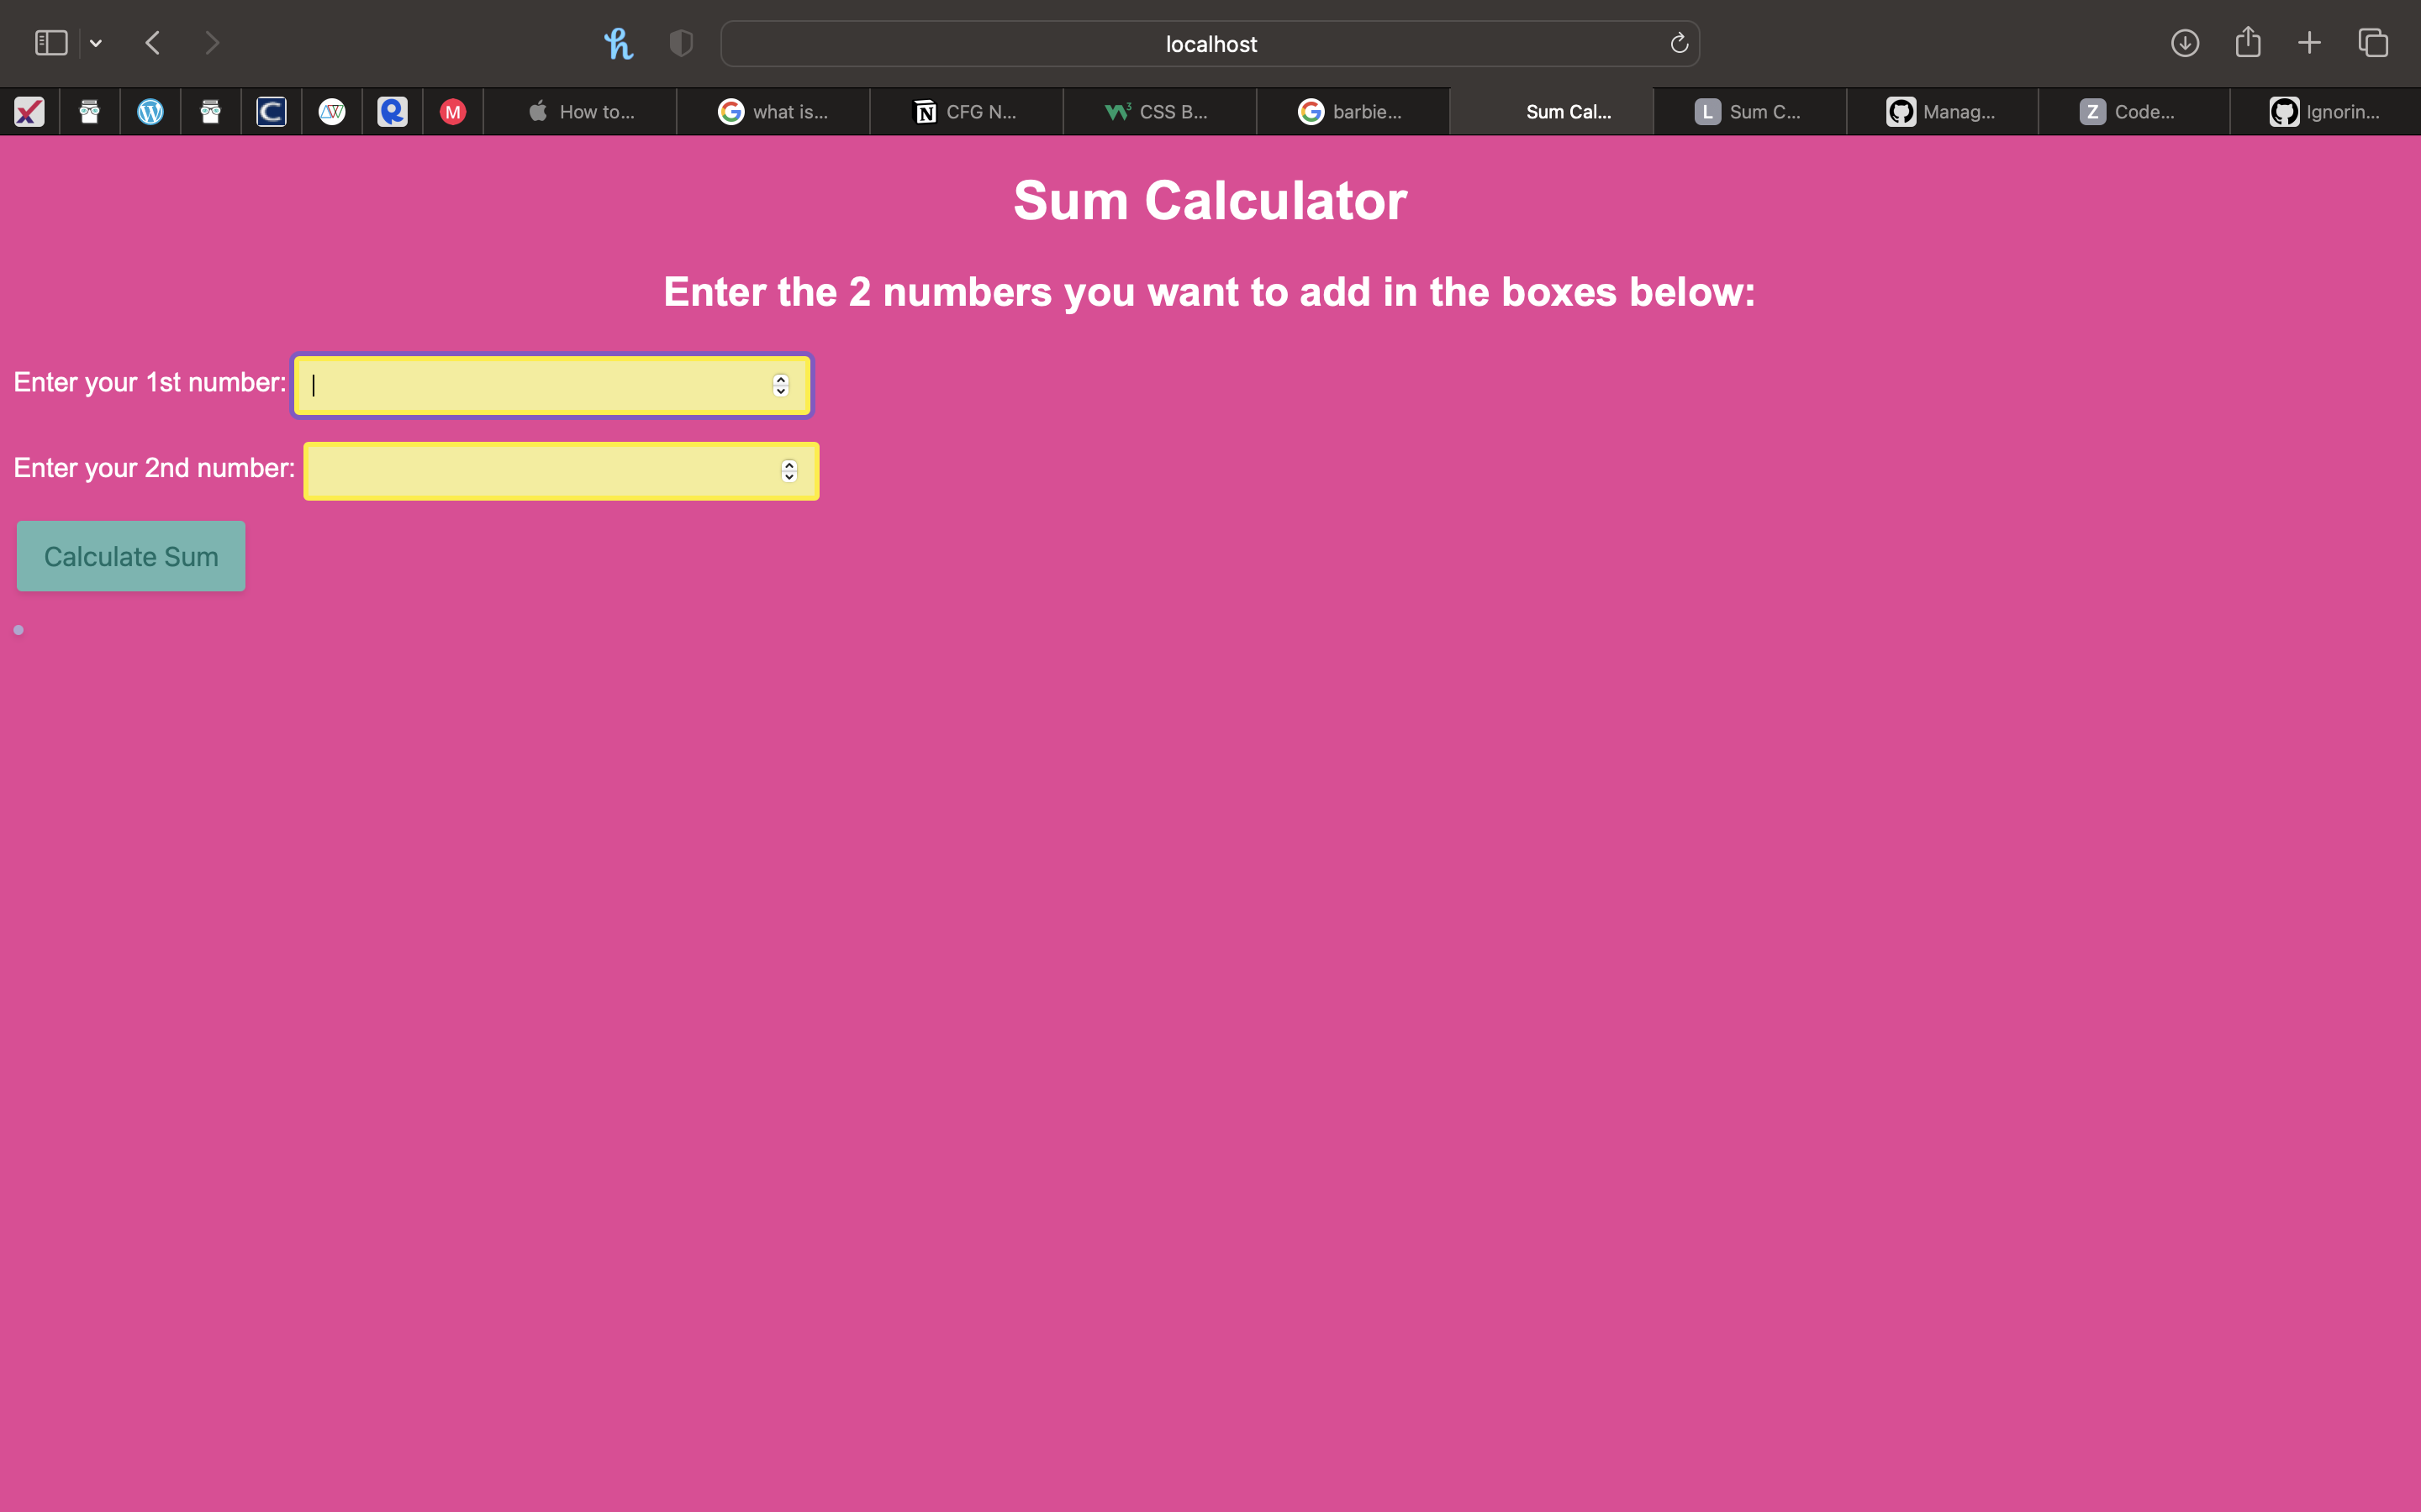
Webpage on localhost

Slide 3
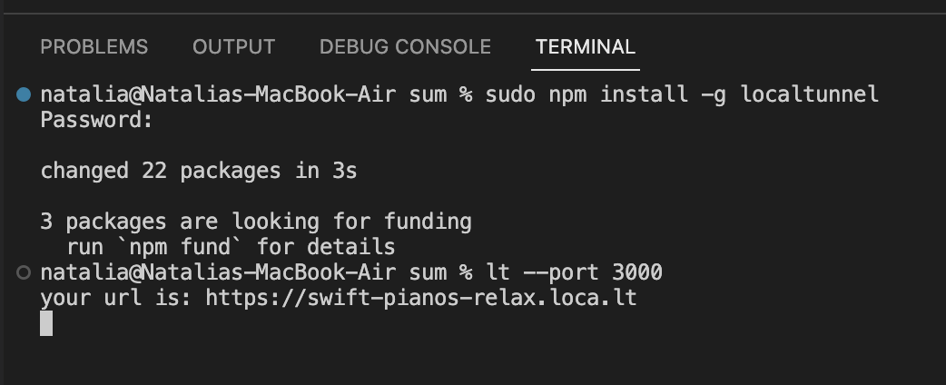
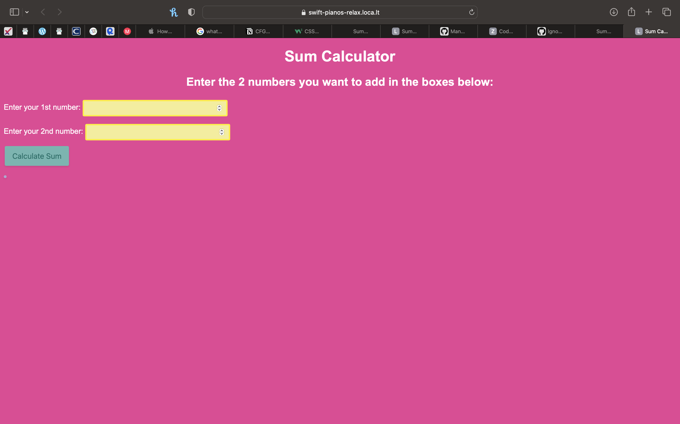
Webpage on localtunnel

